Slide 1

Green University of Bangladesh
Dept. of Computer Science & Engineering
Presented By:
Sazzad Hossain (201002010 )
Sumaya Bintay Eshak (201002145)
Nadim Mahmud prince (201002)
Submitted to:
Tanoy Debnath
Lecturer
Dept. of Computer Science Engineering
01

Slide 2



HOSTEL MANAGEMENT SYSTEM
02

Slide 3
Contents
Introduction
Motivation
Objectives
Related Works
Projects Features
SDLC Model Selection
Use case Diagram
DFD Diagram
ER– Diagram
Implementation
Tools & Techniques
Testing
Limitations & Future Scope
Conclusion
03

Slide 4
The primary goal of the Hostel Management System is to replace outdated and manual methods of hostel management with a robust, user-friendly, and automated solution.
Introduction
04

Slide 5
Improved Communication
Cost Effective
Simple and Understandable Design
Motivation
05

Slide 6
To Have a User-Friendly Interface
To provide Realtime support
To provide better cost saving app
Objectives
06

Slide 7

Related works
https://www.istockphoto.com/
07

Slide 8
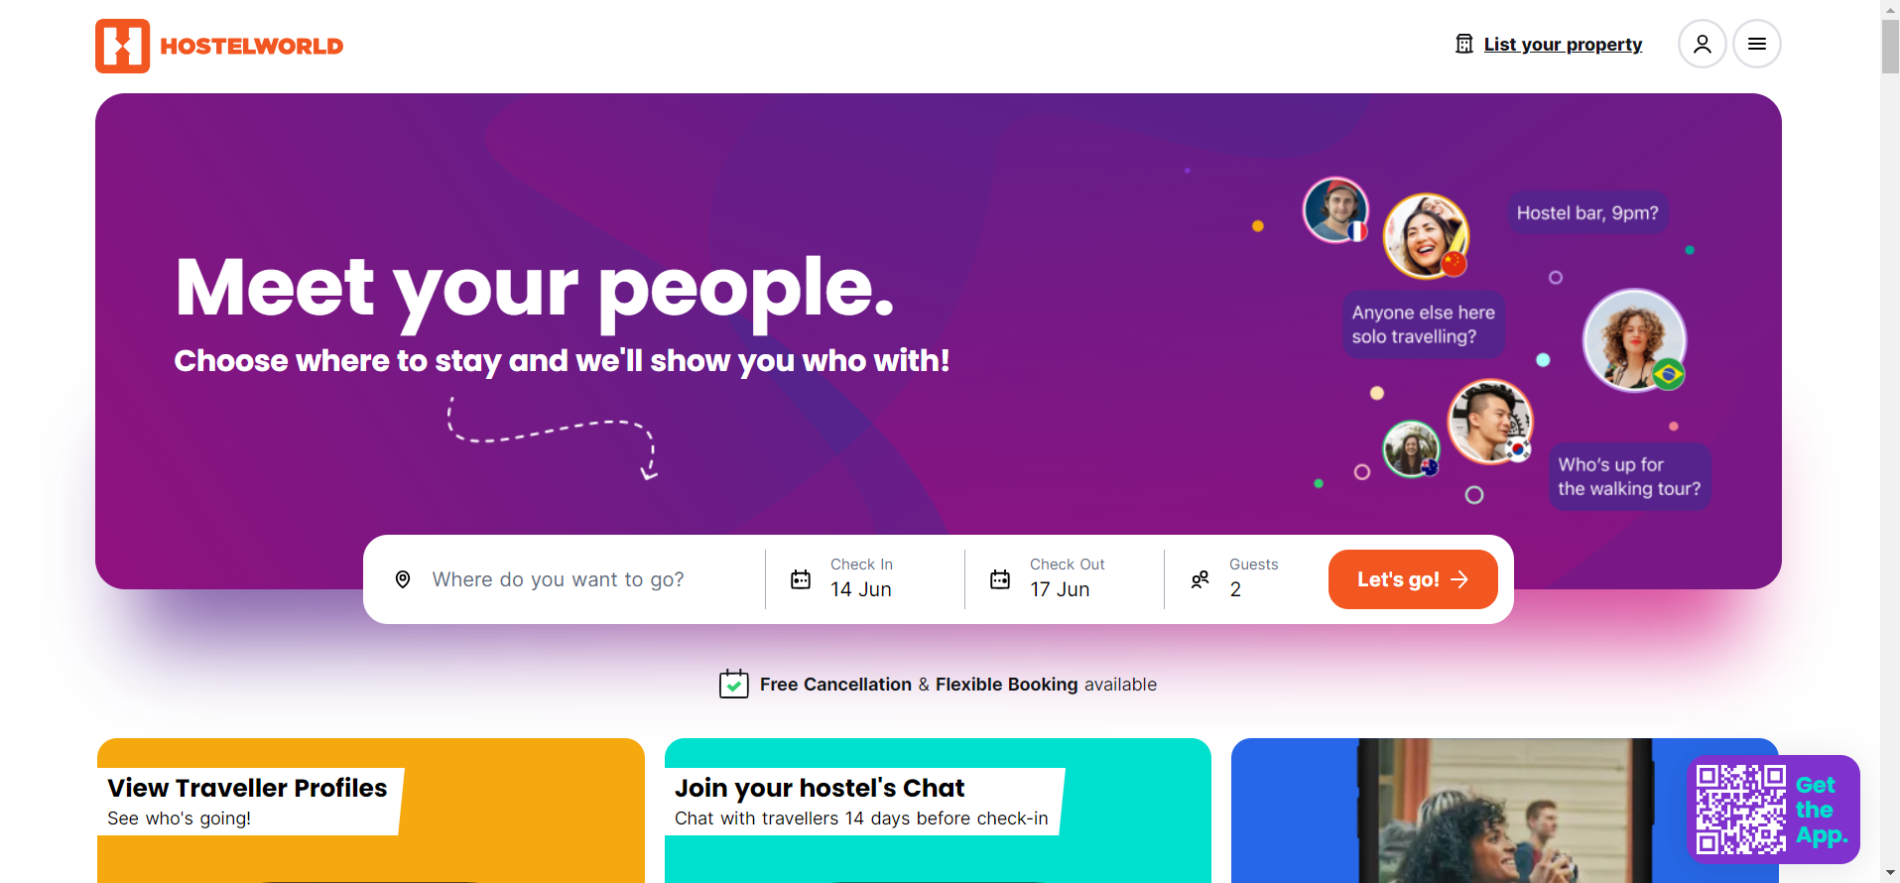
Related Works
Instructory
Findings:
Reviews & Ratings
Online Booking Platform
Limitations:
Limited Direct Communication
Doesn’t have food information
Doesn’t have location information
https://www.hostelworld.com/
08

Slide 9
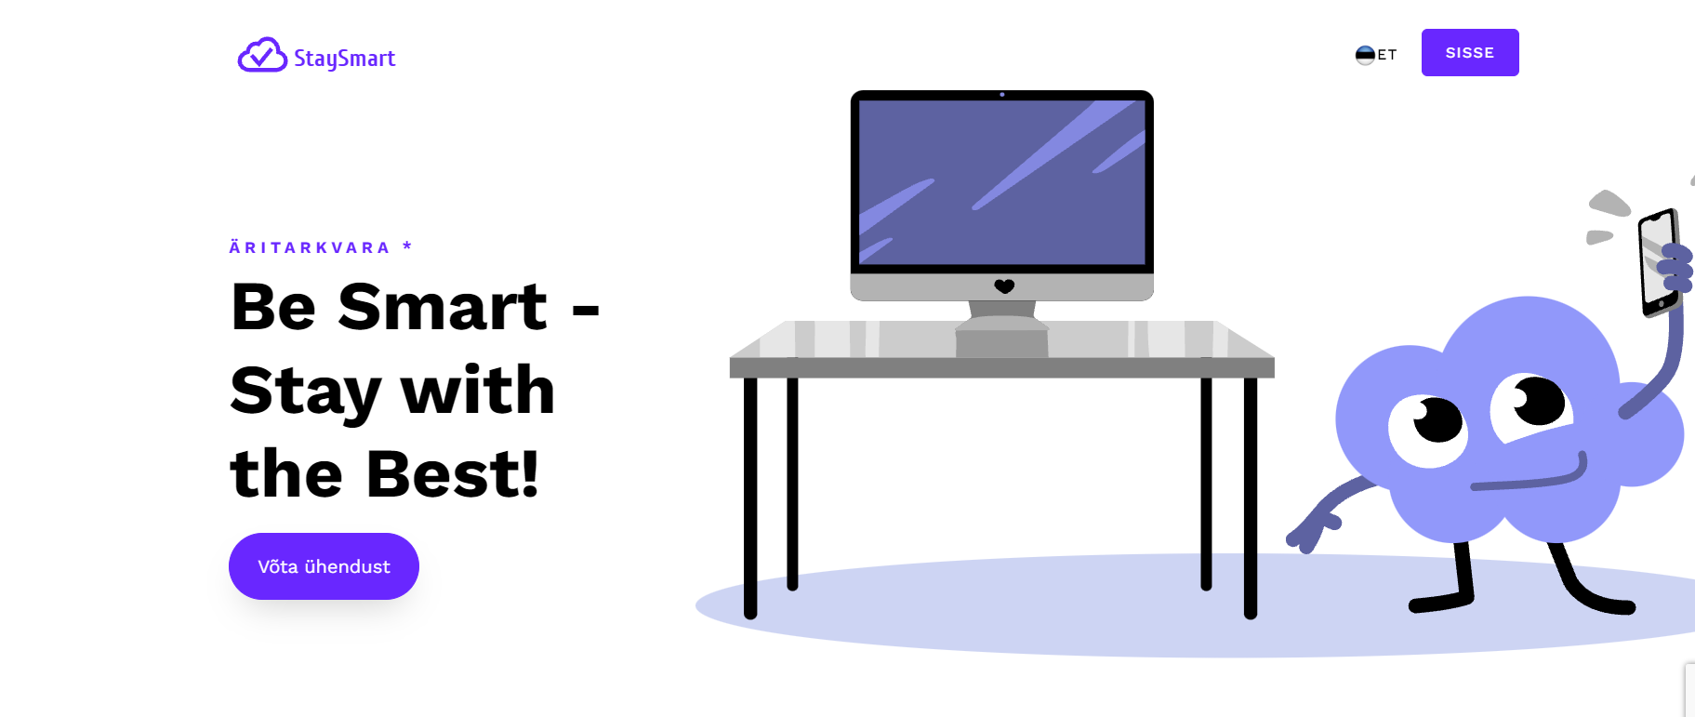
Related Works
Instructory
Findings:
Efficient Reservation Management
Integrated Billing and Payment
Limitations:
Billing methods run on international banking system
Complex design
https://staysmart.ee/
09

Slide 10
Project Features
Room Allocation and Meals Selection
Communication and Reviews
Location Based Availability
10

Slide 11
This project we use V-shape model,
The V-Model, also known as the Verification and Validation Model. In the V-Model, each phase of the development process has a corresponding testing phase on the other side of the V. This includes determining the desired functionalities, user roles, system constraints, and performance expectations.
SDLC MODEL SELECTION
11

Slide 12
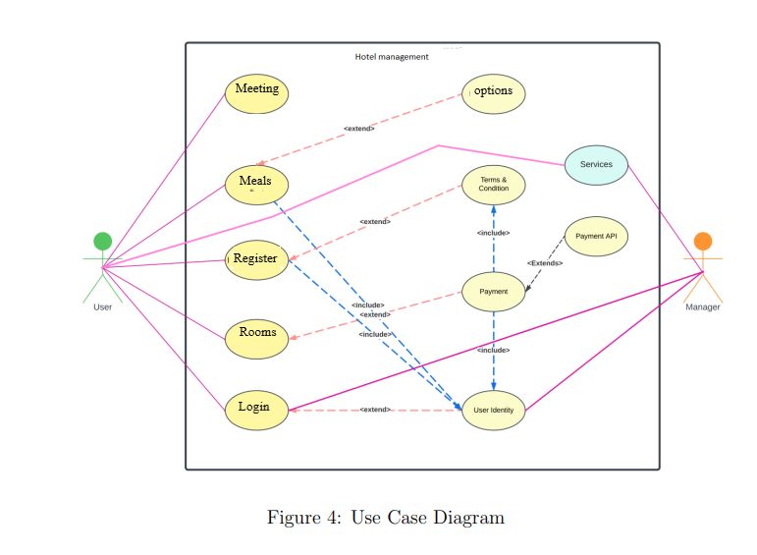
Use Case Diagram
12

Slide 13
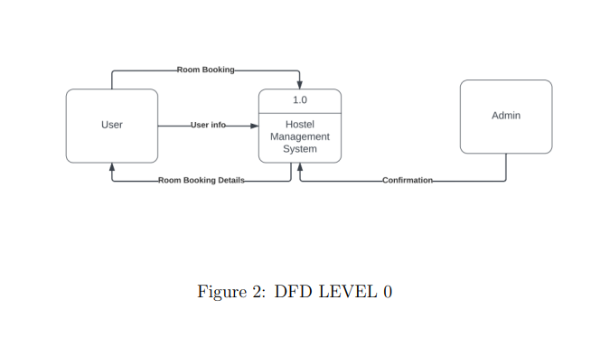
DFD Diagram(Level 0)
13

Slide 14
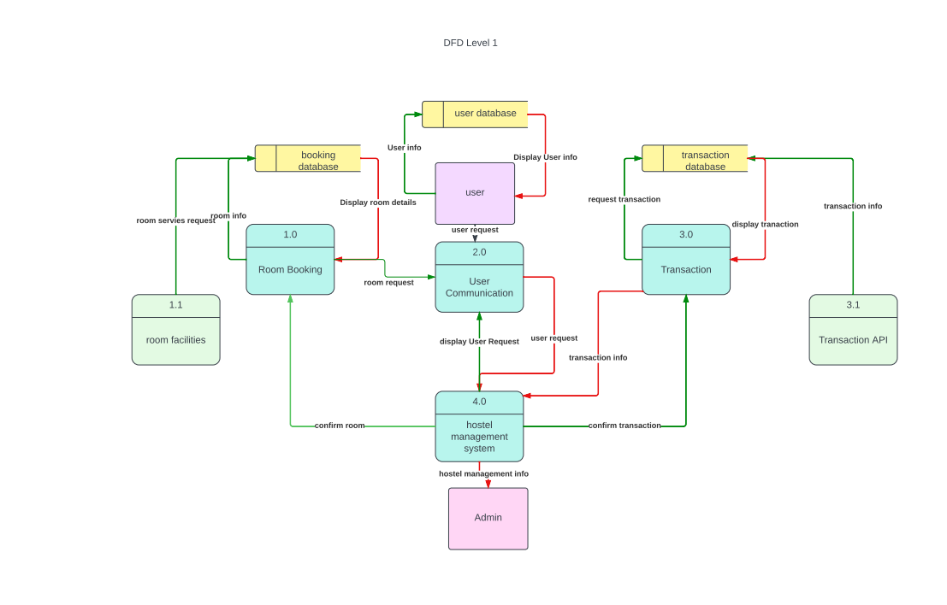
DFD Diagram(Level 1)
14

Slide 15
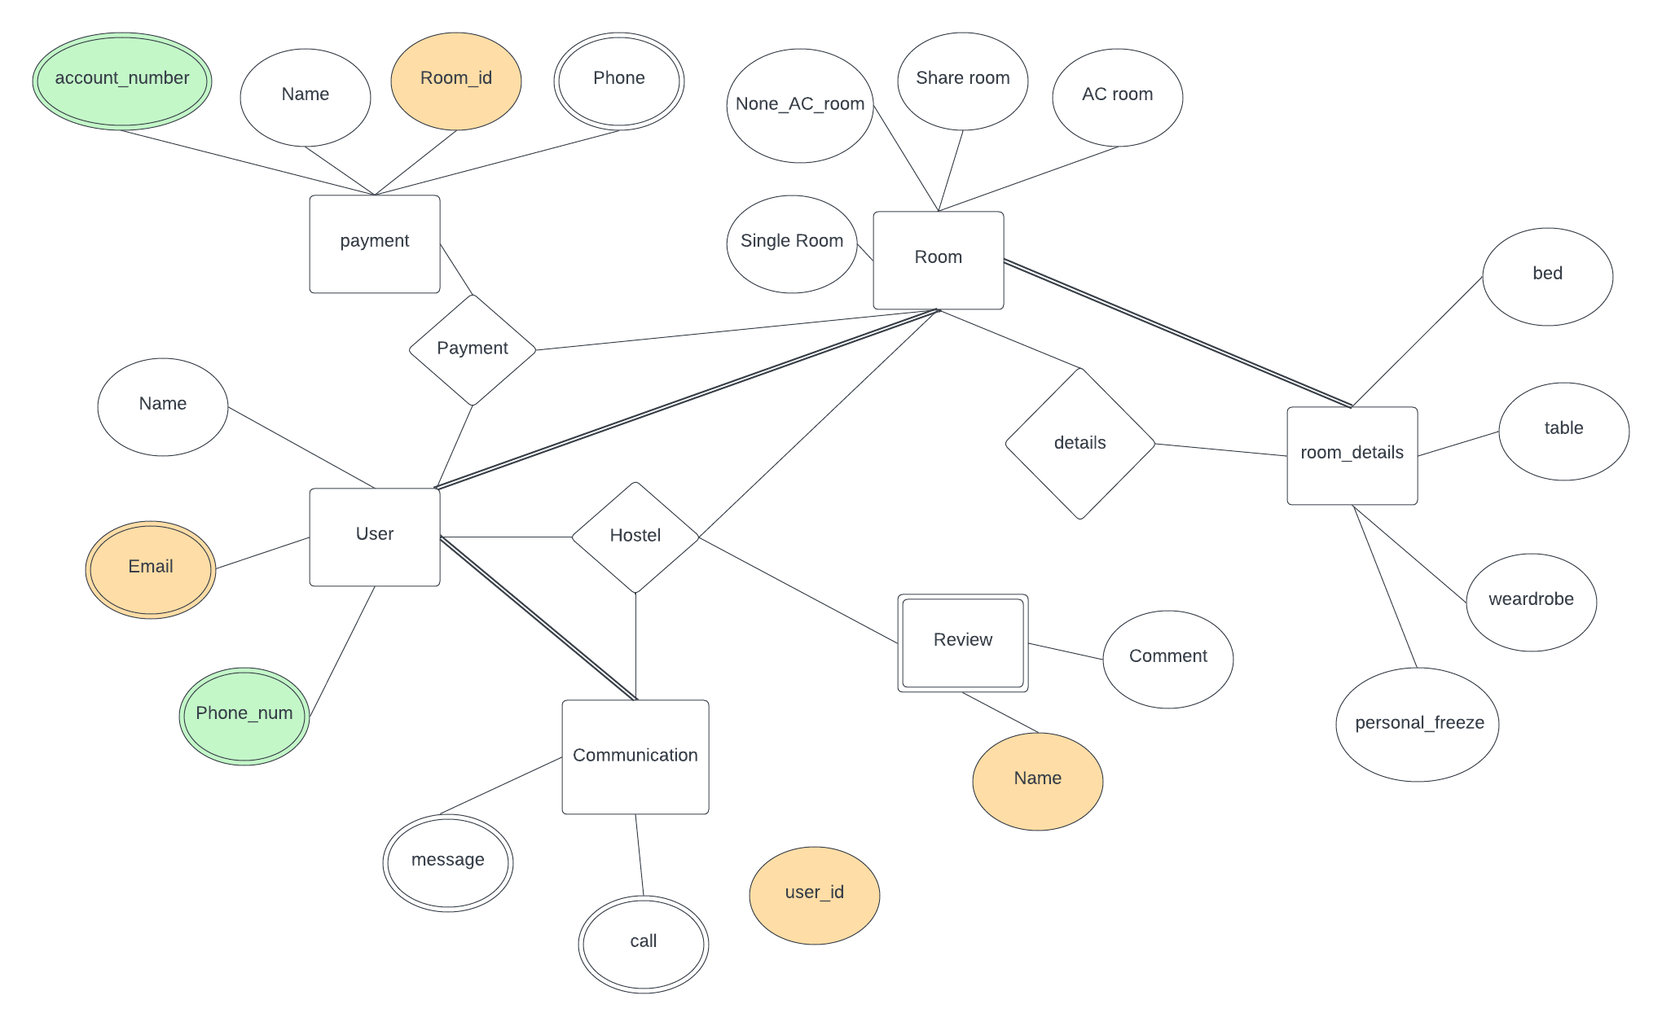
ER– Diagram
15

Slide 16
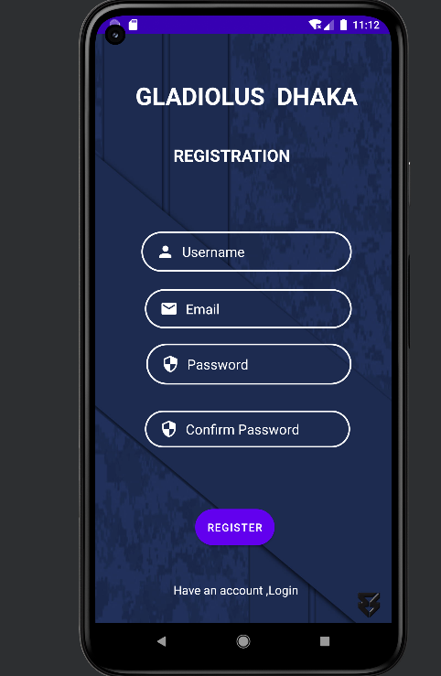
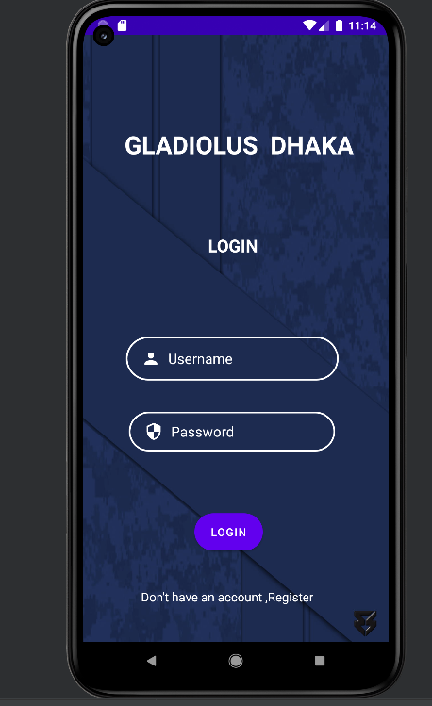
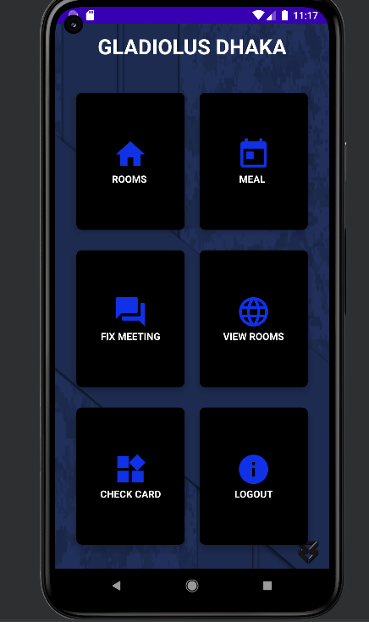
Implementation
16

Slide 17
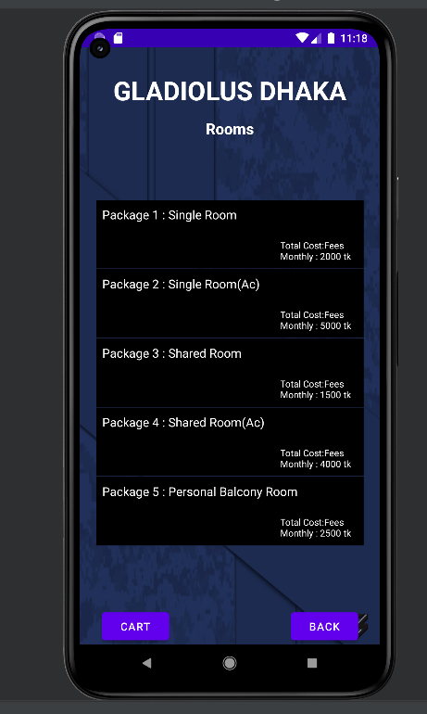
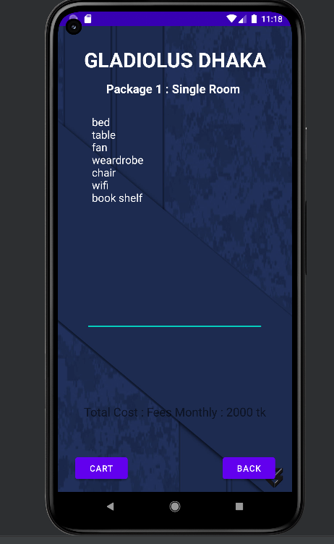
17

Slide 18
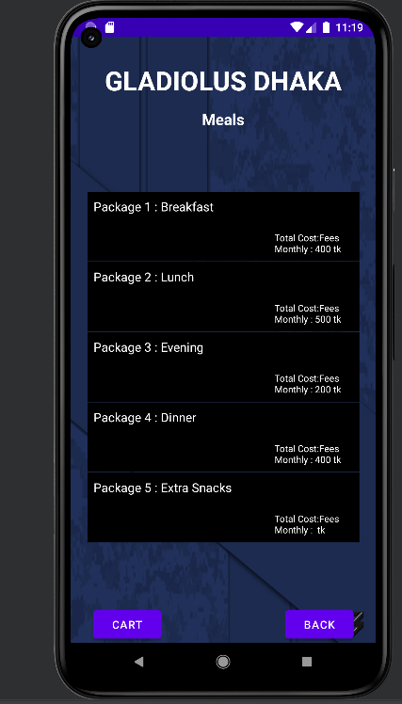
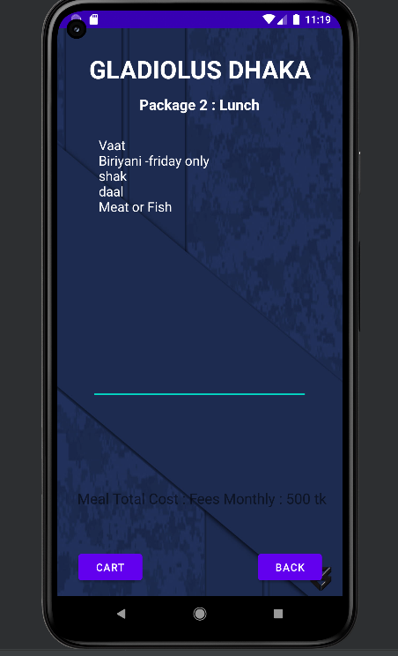
18

Slide 19
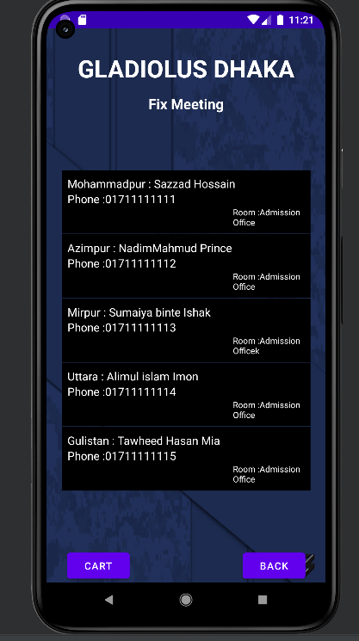
19

Slide 20
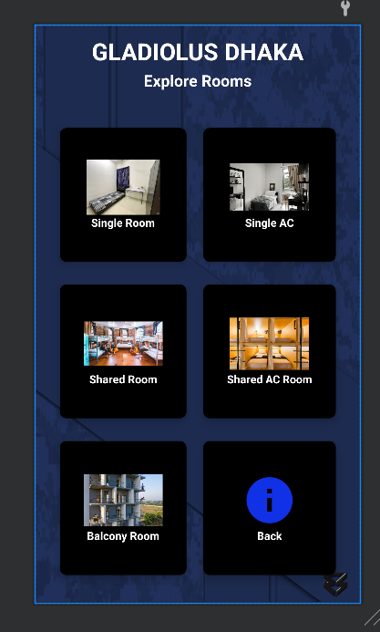
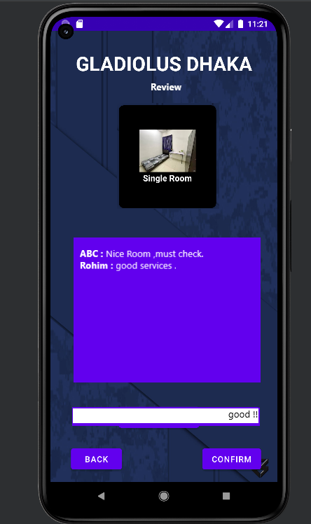
20

Slide 21
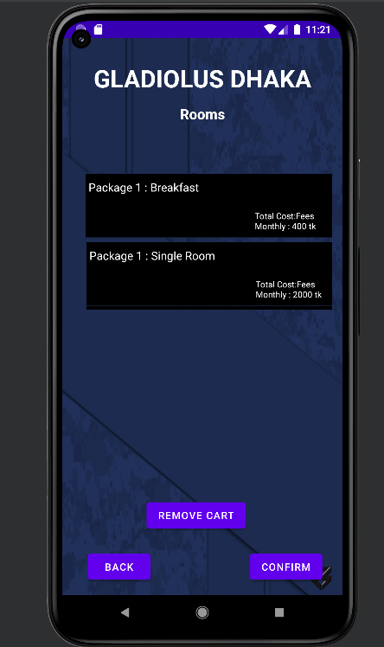
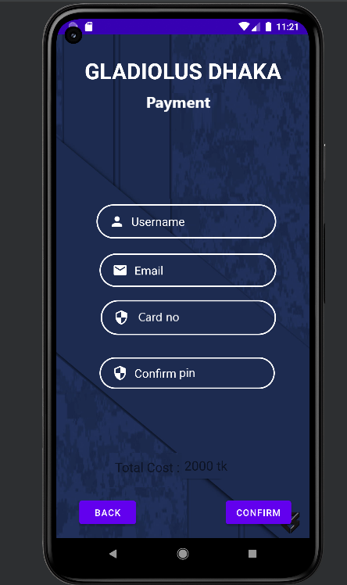
21

Slide 22
Frontend
XML
Tools & Techniques
Backend
Java
SQLite
Tools:
Android Studio
22

Slide 23

Testing
Additionally, gathering feedback from potential
end-users during the testing phase can provide valuable insights for improving the system's functionality and usability.
23

Slide 24
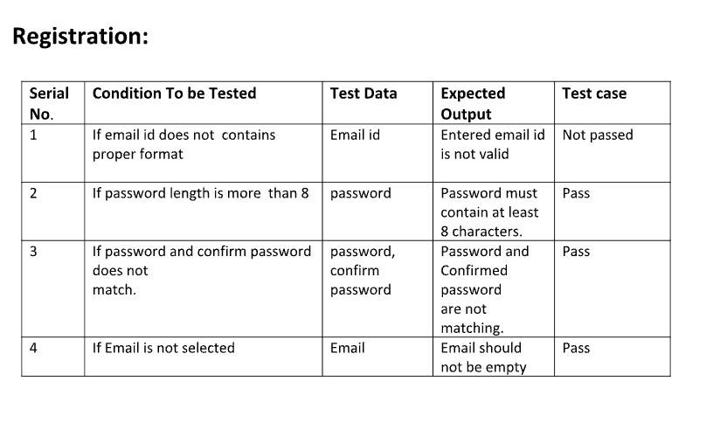
Registration Testing
24

Slide 25
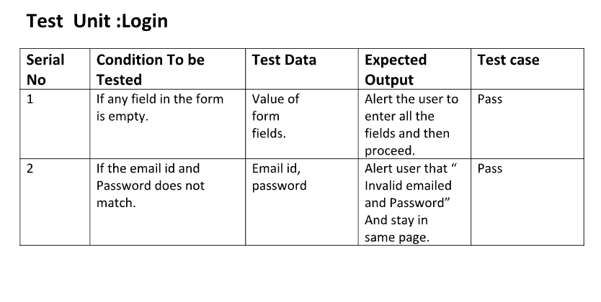
Login Testing
25

Slide 26
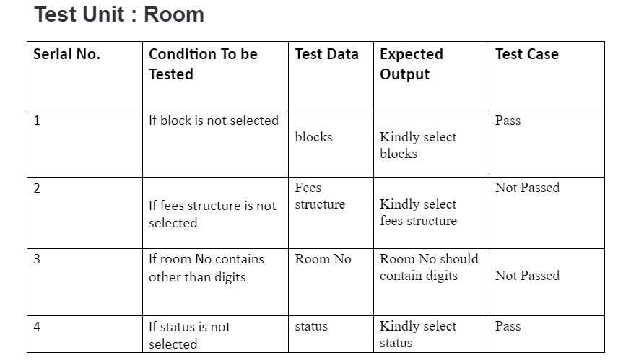
Room Testing
26

Slide 27
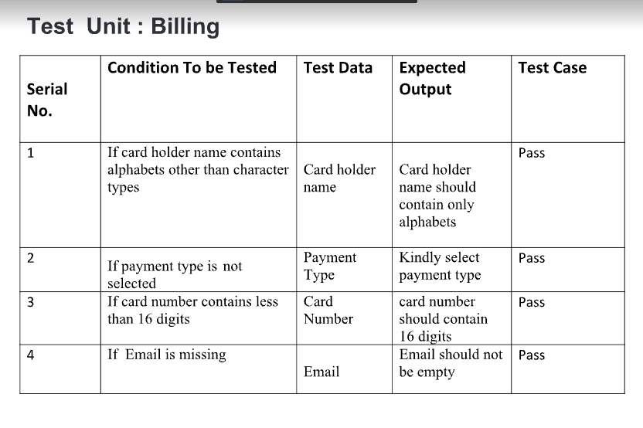
Billing Testing
27

Slide 28
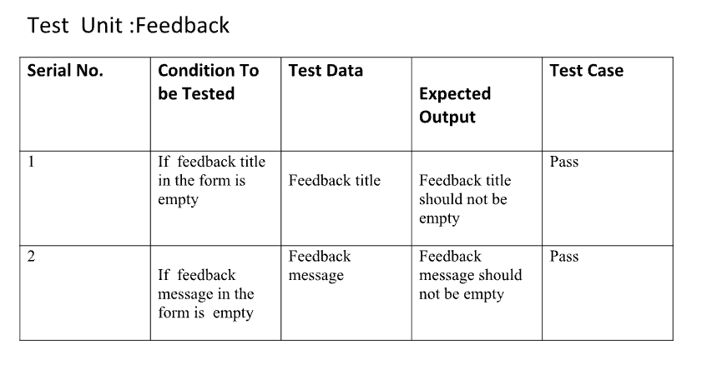
Feedback Testing
28

Slide 29
Limitation
There is few bugs with payment method which can be solved with an update .
Because of using SQLite there can be data complexity .
Needs more update to improve performance .
Future Scope
The future scope of a hostel management system is promising,with numerous advancements on the horizon.Mobile Application will play a crucial role in enhancing accessibility and convenience for administrators,staff and residents.
29

Slide 30
In conclusion, an integrated design project for a hostel management system holds immense potential for streaming operations, enhancing guest experiences, and improving overall efficiency.
Conclusion
30

Slide 31
Any
Questions
31

Slide 32
THANK YOU!
32

